Slide 1

Maths art integrated project
GROUP PROJECT:

Slide 2
INDEX:
HISTORY OF CHARMINAR.
MATHEMATICAL REPRESENTATION .
HOW TO FIND HEIGHT OF THE MONUMENT?
NAGARJUNA DAM .
STATISTICS TABLE .
MEAN , MODE ,MEDIAN OF THE TABLE.

Slide 3
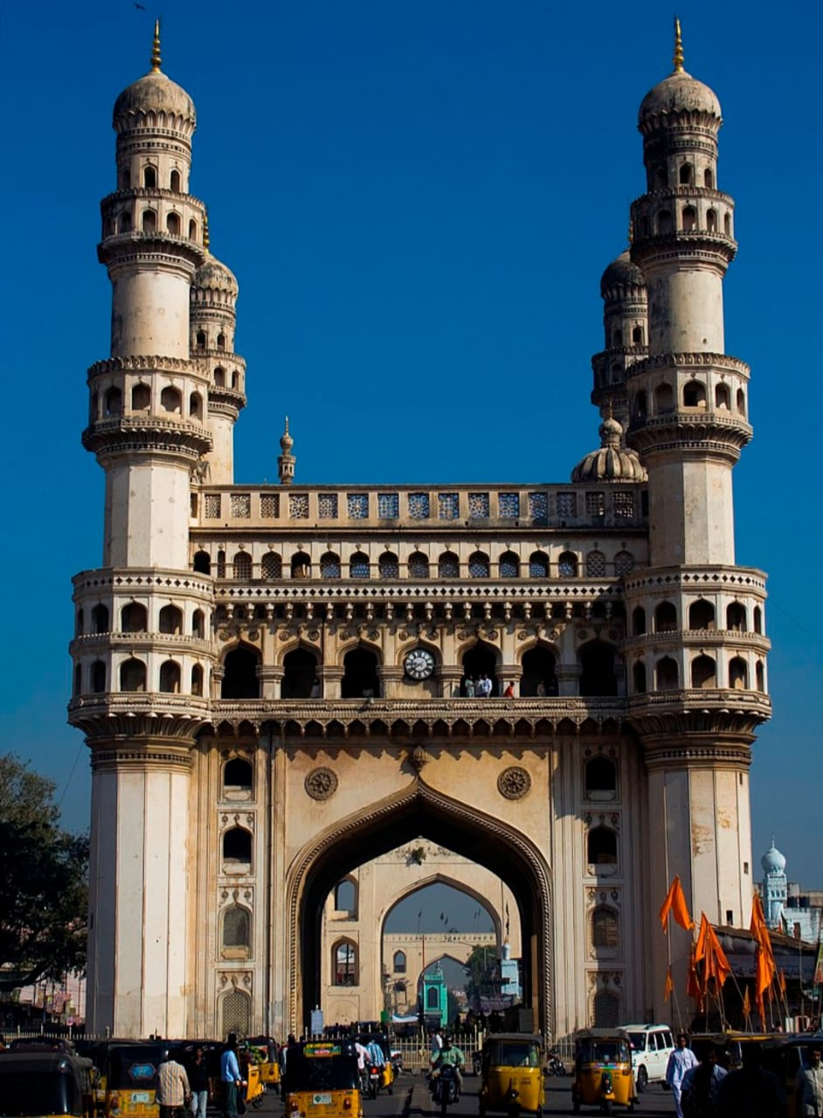
HISTORY OF CHARMINAR
THE Charminar (lit. 'four minarets') constructed in 1591, is a monument located in Hyderabad, TelTangana, India. The landmark has become known globally as a symbol of Hyderabad and is listed among the most recognised structures in India. It has also been officially incorporated as the Emblem of Telangana for the state of Telangana. The Charminar's long history includes the existence of a mosque on its top floor for more than 400 years. While both historically and religiously significant, it is also known for its popular and busy local markets surrounding the structure, and has become one of the most frequented tourist attractions in Hyderabad. Charminar is also a site of numerous festival celebrations, such as Eid-ul-adha and Eid al-Fitr.
The Charminar is situated on the east bank of Musi river. To the west lies the Laad Bazaar, and to the southwest lies the richly ornamented granite Makkah Masjid.^{[6]} It is listed as an archaeological and architectural treasure on the official "List of Monuments" prepared by the Archaeological Survey of India. The English name is a translation and combination of the Urdu words chār and minar or meenar, translating to "Four Pillars"; the eponymous towers are ornate minarets attached and supported by four grand arches.

Slide 4
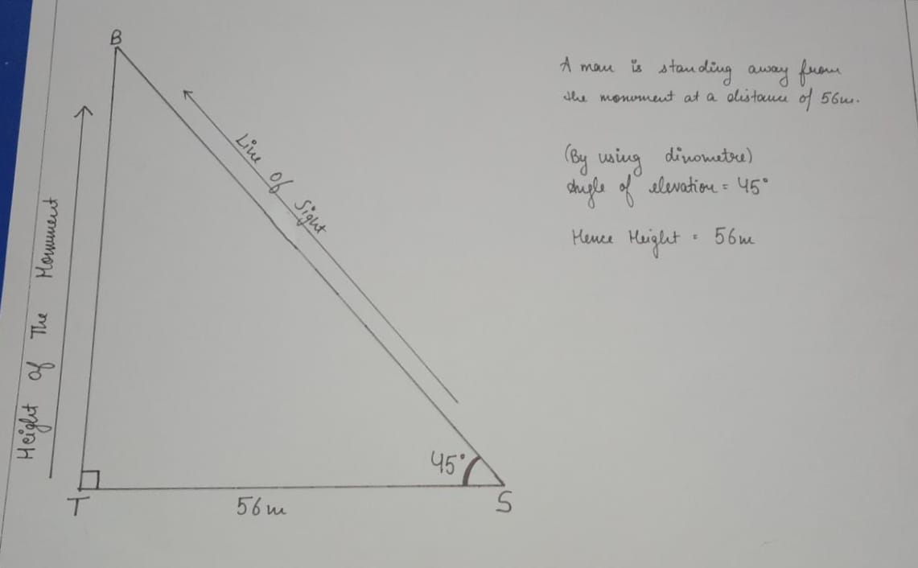
MATHEMATICAL REPRESENTATION OF MONUMENT

Slide 5
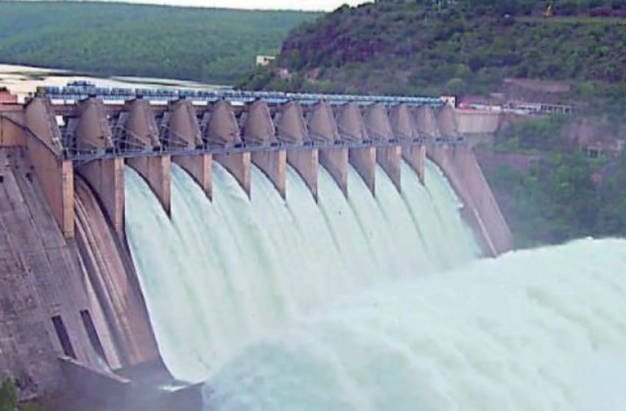
NAGARJUNA DAM
Nagarjuna Sagar Dam is a masonry dam across the Krishna River at Nagarjuna Sagar which straddles the border between Nalgonda district in Telangana and Guntur district in Andhra Pradesh.^{[2]} The dam provides irrigation water to the Nalgonda, Suryapet, Krishna, Khammam, West Godavari, Guntur, and Prakasam districts along with electricity generation.
Constructed between 1955 and 1967, the dam created a water reservoir with gross storage capacity of 11.472 billion cubic metres (405.1×10⁹ cu ft). The dam is 490 feet (150 m) tall from its deepest foundation and 0.99 miles (1.6 km) long with 26 flood gates which are 42 feet (13 m) wide and 45 feet (14 m) tall.^{[3]} It is jointly operated by Andhra Pradesh and Telangana.^{[2][4]}
Nagarjuna Sagar Dam was the earliest in a series of large infrastructure projects termed as "modern temples" initiated for achieving the Green Revolution in India. It is also one of the earliest multi-purpose irrigation and hydroelectric projects in India

Slide 6
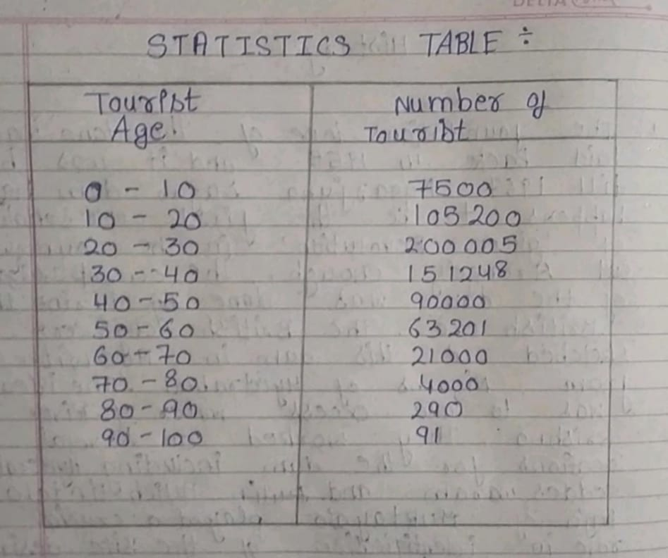
STATISTICS TABLE

Slide 7
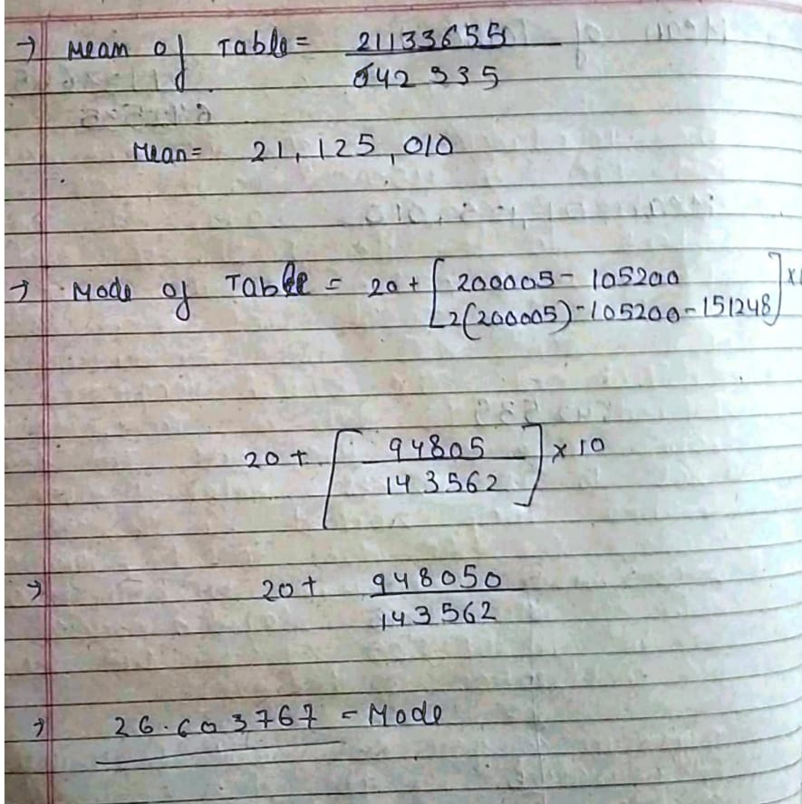
MEAN AND MODE OF THE TABLE

Slide 8

MEDIAN OF THE TABLE

Slide 9
ACKNOWLEDGEMENT
WE ARE REALLY GRATEFUL BECAUSE WE MANAGED TO COMPLETE OUR MATHS PROJECT WITHIN THE TIME GIVEN BY OUR LECTURER MR.PROMOD SIR . THIS ASSIGNMENT CANNOT BE COMPLETED WITHOUT THE EFFORT AND CO-OPERATION FROM OUR GROUPMEMBERS PREM YADAV,KANGANA MENDIRATTA,SAPNA,MUSKAN VERMA. LAST BUT NOT THE LEAST , WE WOULD LIKE TO EXPRESS OUR GRATITUDE TO OUR FRIENDS AND RESPONDENTS FOR THE SUPPORT AND WILLINGNESS TO SPEND SOME TIMES WITH US TO FILL IN THE QUESTIONAIRES.

Slide 10
GROUP MEMBERS
KANGANA MENDIRATTA
PREM YADAV
SAPNA KUMARI
MUSKAN VERMA

